Slide 1



Specific needs and expectations: Workers & Employers main issues and challenges to address practical advices
Neeraj Shandilya
TNO, Netherlands

Slide 2
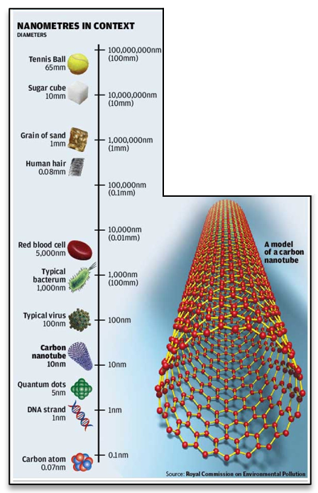
Overview
01.
Health effects on the workers
02.
Regulation and challenges
03.
Identification of NMs and their exposure to workers
04.
Medical surveillance and needs
05.
Recommendations for sector-specific exposure control measures
- healthcare
- maintenance
- Construction

Slide 3
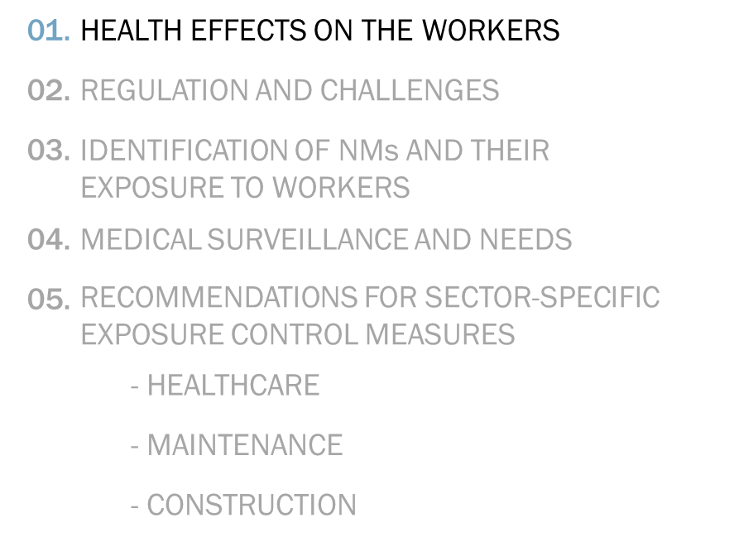

Health effects on the workers
NMs interact with biological systems differently from larger particles of the same material.
Larger surface area may be reflected in increased biological reactivity.
Influence of surface treatment/coating
Different worker exposure routes:
  Inhalation: breathing the airborne solid particles or mist particles in
  Dermal: contact with the skin due to splashes or deposited aerosols
  Oral: swallowing due to poor occupational hygiene
Uncertainty on the extent to which the various characteristics of NMs influence toxicity
Source: Barhoum et al. 2022; https://doi.org/10.3390/nano12020177

Slide 4
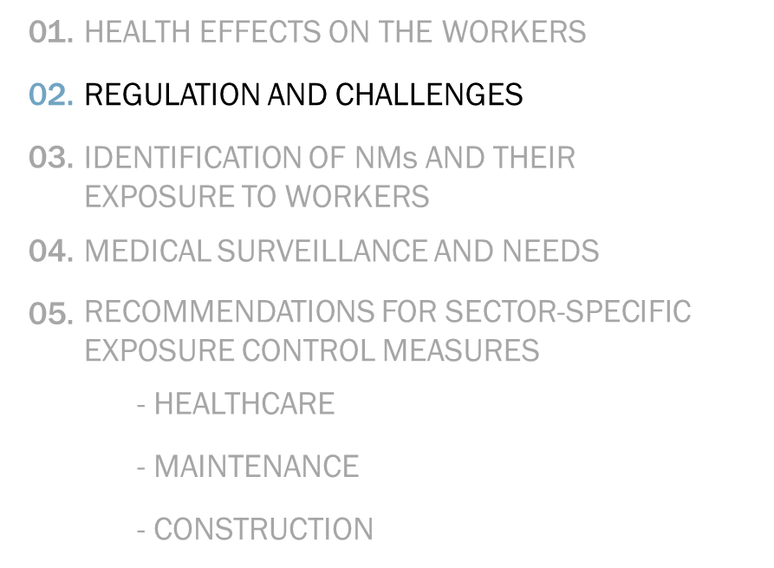
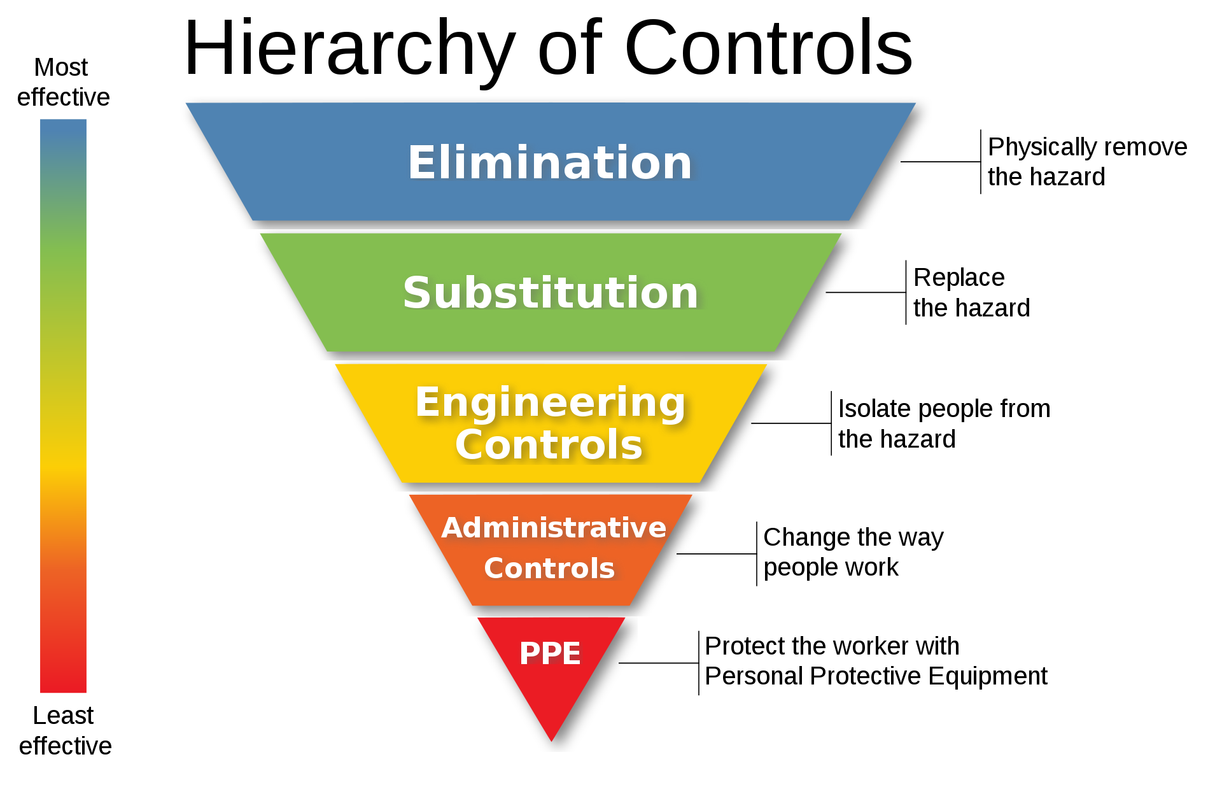
Regulations (1/2)
EU Framework Directive 89/391/EEC,
Chemical Agent Directive 98/24/EC,
Regulation (EC) 1272/2008 on CLP,
Carcinogen and Mutagen Directive 2004/37/EC,
Substance specific legislation
Chemicals: REACH 1907/2006 Cosmetic products: 1223/2009
Medical devices: 178/2002 & 1223/2009 Biocides: 528/2012
Food contact materials: 10/2011
Employers must assess and manage any (potential) worker risk
A precautionary approach to risk management and the choice of prevention measures
If the risk cannot be eliminated or substituted, EU-OSHA mandates implementation of prevention measures
  engineering controls (e.g. LEV, worker encloser, source segregation),
  administrative controls (e.g. standard procedures, training, warnings)
  personal protective equipment (e.g. safety glasses, respirators, protective clothing)

Slide 5

Regulations (2/2)
At the EU level, the relevant documentation development is led largely by:
  CEN/TC 137 – Assessment of workplace exposure to chemical and biological agents
  CEN/TC 195 – Air filters for general air cleaning
  OECD’s Working Party for Manufactured Nanomaterials
Potential for regulatory gaps:
  thresholds set within regulations may be inappropriate for nanomaterials
  narrow in scope and interpretation for their applicability to NMs
  often judgments need to be exercised
  Need for the standardisation to support the preparation of MSDS for NMs labelling

Slide 6
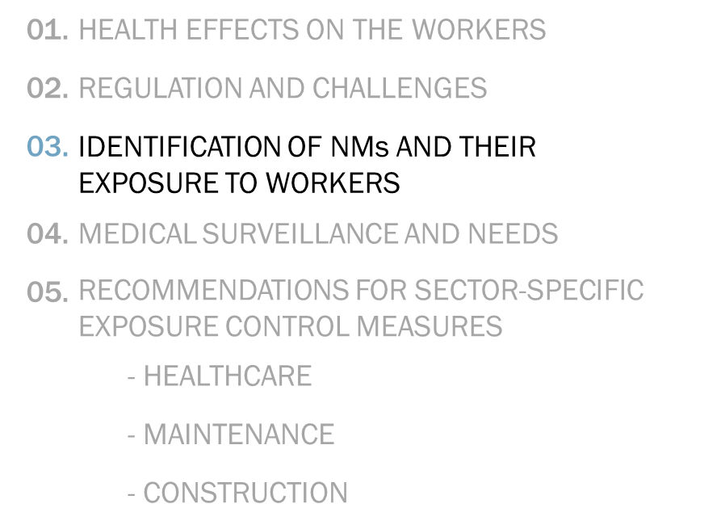
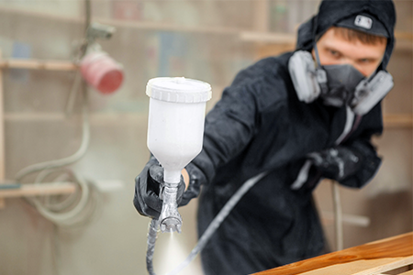
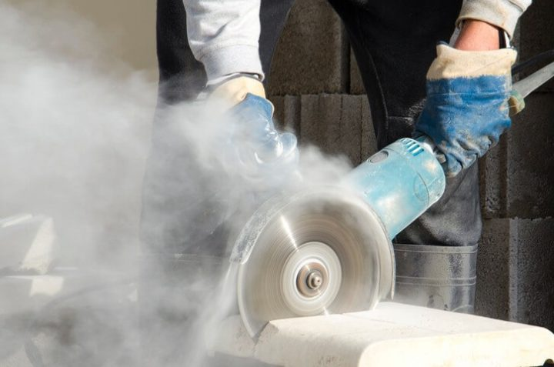
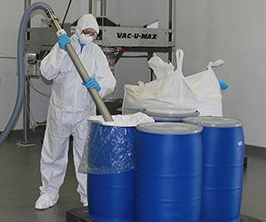
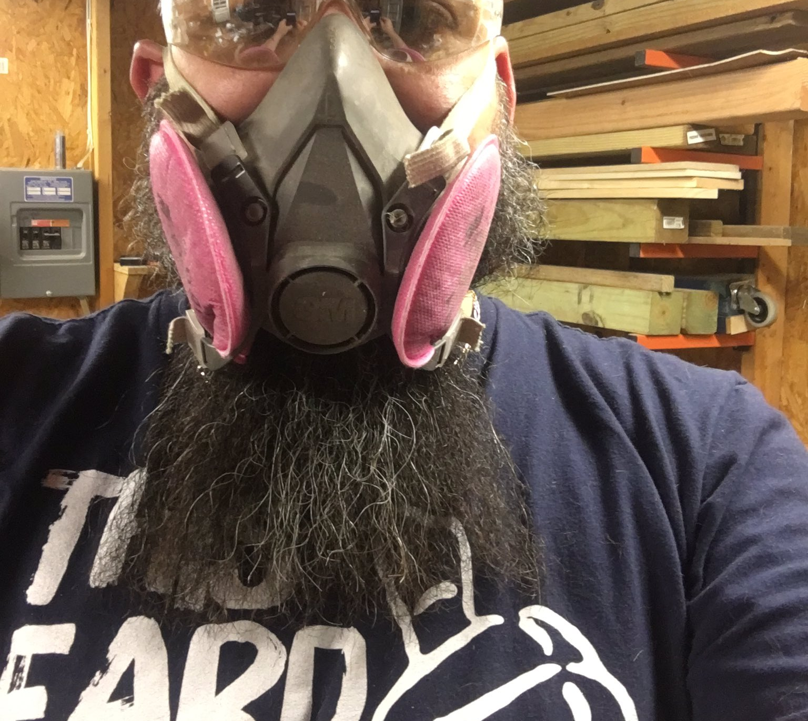
Identification of NMs and exposure to workers
Information on the product labels, in the safety data sheets and in the technical specifications
In case of uncertainty, safety manager/OSH professional should either advise the worker directly or seek confirmation from the supplier whether or not nanomaterials are present.
If still unclear, the employer should arrange workplace analysis through onsite exposure measurements (e.g. handheld particle counters, microscopic analysis)
Use of web-based interactive tools (Stoffenmanager nano, CB nanotool, Nano Risk Quantifier etc.)
Situations with exposure likeliness:
  (frequently) impacting contaminated surfaces or objects,
  working with dusty powders,
  low viscosity and/or high vapor pressure liquids,
  cutting, abrading or grinding nano-enabled objects,
  improper use of PPEs etc.

Slide 7
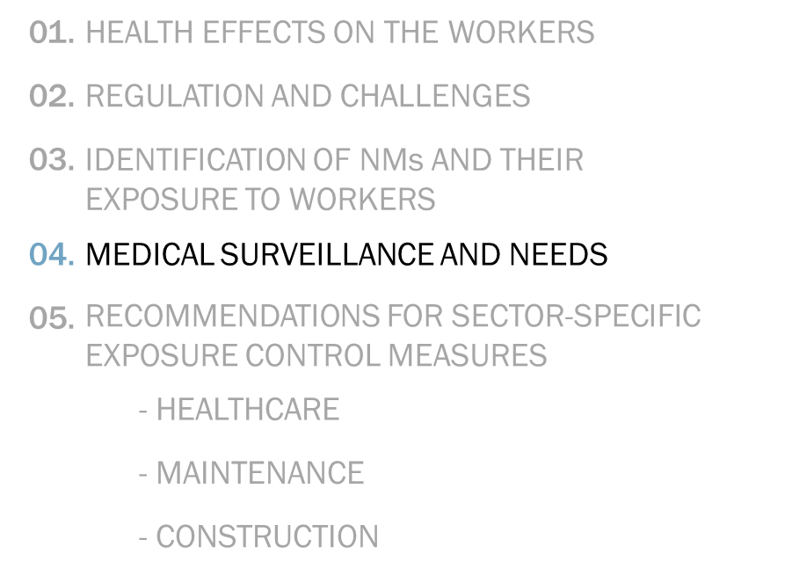
Medical surveillance & Needs (1/2)
Surveillance of actual health events or a change in a biologic function of exposed worker(s)
Second line of defense behind the implementation of engineering, administrative, and work practice controls
Vital elements include initial medical examination with other periodic examinations at regularly scheduled intervals and post-incident examinations
A worker is trained to recognize symptoms of exposure to a given hazard
Medical as well as socioeconomic benefits (fewer cases of disability, lower direct costs and productivity losses, incremental cost effectiveness ratio)
No medical surveillance standards at European level specific to NMs
  Insufficient evidence to recommend the use of specific medical screening or surveillance of exposed workers
Preventive and precautionary approach: taking prudent (hierarchic) measures to minimize worker exposure

Slide 8
Medical surveillance & needs (2/2)
For the early detection and prevention of (long-term) worker health risks, several directives (but not specific to NMs) can be relevant:
  OSH Framework Directive 89/391 Carcinogens directive 2004/37/EC
  Biological agents directive 2000/54/EC Chemical agents Council directive 98/24/EC
Biomonitoring of adverse health effects using validated candidate biomarkers
Development of exposure registries where longitudinal follow-up studies should inform surveillance
Known exposure measurements or summary indices for NMs as a reference
More studies on the comparison of the effects of the surveillance approaches to usual care, e.g. those commonly followed for bulk-size hazardous materials.

Slide 9
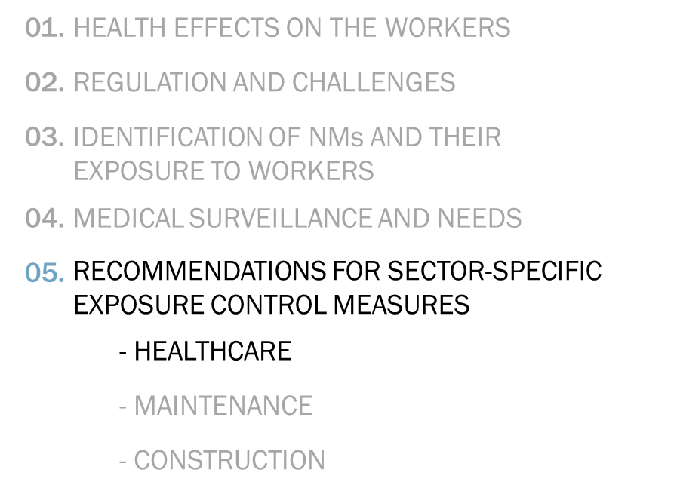
sector-specific exposure control measures- healthcare sector
Impossible to install technical systems for reducing or preventing exposure at source at most workplaces
Preparation of drugs (e.g. tablets or ointments) containing NMs in glove boxes
Use of clean benches with HEPA filters during preparation of nanodrugs, sampling patients’ tissues, body fluids or excrements, preparation or analysis of samples using analytical chemicals with NMs.
Use of a high-throughput ventilation system in combination with PPE, particularly gloves and masks in case of exposure to spills, dusts or vapors
LEV systems are normally installed in workplaces like laboratory, surgery rooms or storage areas to prevent infection risk
  For LEV to be suitable to NMs, use of normal multistage filters, with HEPA H14 filters or ultra-low penetration air filters, as the final filter before re-introduction of the extracted air is recommended

Slide 10
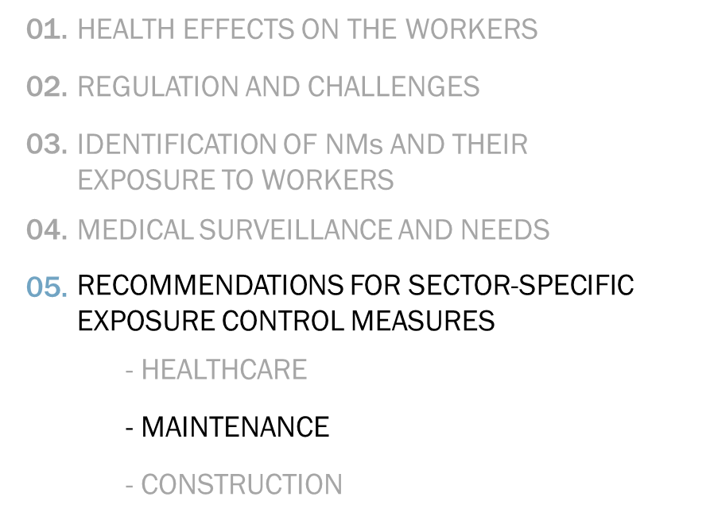
sector-specific exposure control measures- maintenance sector
Containment through the use of closed systems and enclosed installations.
If containment is infeasible, use of suitable effective local exhaust ventilation systems with a HEPA or ULPA filter to capture NMs at source
When the maintenance work itself consist of inspecting and repairing the technical controls, workers should rely on the use of PPEs and mobile air extraction systems
  Workers’ breathing zones should not be within the air flow between the potential NM emission source and the exhaust extraction system.
Exposure controlling ventilation systems must have multi-stage filters with HEPA (H14) or ULPA filters as the final filter

Slide 11
sector-specific exposure control measures- construction sector (1/2)
Cement and concrete materials, and coatings and paints share some of the largest market of nanoproducts.
No special exposure control measure needed in absence of dust generation (e.g. pouring concrete, stripping the formwork, cleaning formwork).
Activities like spraying concrete, drilling in concrete, blowing out boreholes which generate a lot of aerosol/dust should be performed with protective measures in place:
  Concrete should be sprayed while wearing a full protective suit with helmet with forced ventilation
  Systems like extraction drill or vacuum cleaner adapter should be installed during drilling in concrete or dust removal during blowing out boreholes.
  The drivers of the construction machines and vehicles should keep their vehicles’ doors and windows closed.
  The construction site roads should be kept moist with water and dust binder.
  When demolishing any concrete structure, tools like jackhammer with extraction and air cleaner should be used.
  When using an excavator, the worker inside its cabin should keep the doors and windows closed, while the worker near or between the excavators should wear helmet with forced ventilation.

Slide 12
sector-specific exposure control measures- construction sector (2/2)
While working with paints and coatings, especially during spraying, ventilation is crucial.
Exhaust ventilation system with a HEPA filter drives airborne NMs away from the immediate workspace.
Exposure risks are lower when using a brush or roller than when using a spray-pistol.
Use of respirators (with FFP3 filter) or self-contained breathing devices while paint spraying.
Use of chemical goggles, EVOH, rubber, laminate, or gloves prevent skin exposure, coveralls minimize applicator contact, stable and robust boots reduce exposure and prevent slips.
Disposable containers for mixing substances ensure that leftover paint(s) can be removed from the environment quickly.
Contaminated tools must be covered or moved to a well-ventilated location when not in use.
Following each shift, the workers should manage and clean their workspaces to reduce the exposure risk due to the accidental spills.

Slide 13

Thank you for
Your time
Neeraj Shandilya
neeraj.shandilya@tno.nl

